Slide 1
CO4127
Lecture 4 - Introduction to CSS Part 2

Slide 2
Today
Summary of previous lecture
The box model
Margins, borders and padding
Setting margin and padding
Setting borders
Putting it all together
Element display types
Block elements
Inline elements
Breaking flow
Floating
Know your measurements
Clear
Experiment
Important concepts
Sizing
Pseudo selectors
Inheritance
Reading task for this week

Slide 3
The box model

Slide 4
The box model
Every HTML element can be thought of as a box. There are no exceptions.
The box model describes the space taken up by an element and the space it gives itself to other elements.
Here is a diagram of how the Google Chrome element inspector visualizes an element’s box model properties:
Margin
Border
Padding
Content
Use F12 or right-click > ‘Inspect Element’ to access the Google Chrome element inspector box model diagram.
Learn how to use it!

Slide 5
Margins, borders and padding
Margins add space to the outside of an element.
Borders define a stroke around an element between the margin and padding.
Padding defines extra space inside an element around the content.
Margin
Border
Padding
Content
Use F12 or right-click > ‘Inspect Element’ to access the Google Chrome element inspector box model diagram.
Learn how to use it!

Slide 6
Setting margin and padding
Margin and Padding can be set in a couple of ways. Here’s the first:
margin: 10px;
padding: 10px;
CSS
margin: 10px 20px 30px 20px;
padding: 5px 10px 20px 5px;
CSS
Supplying a single value to these properties applies the property to all 4 sides of the box.
Supplying four values applies the property to each side individually starting at the top and working clockwise: Top, right, bottom and left.
It is possible to target individual padding and margin values...
margin: 10px 20px;
padding: 5px 10px;
CSS
When supplied two values, the first applies to the top and bottom, the second to the left and right.

Slide 7
Setting margin and padding
The second way to set Margin and Padding is as follows:
margin-top: 10px;
margin-right: 20px;
margin-bottom: 10px;
margin-left: 20px;
padding-top: 5px;
padding-right: 20px;
padding-bottom: 5px;
padding-left: 20px;
CSS
By specifying values individually you can make your CSS more readable.
Once you’re comfortable using margin and padding, you can switch to the shorthand methods on the previous slide.

Slide 8
Setting margin and padding
margin-top: 10px;
margin-right: 20px;
margin-bottom: 10px;
margin-left: 20px;
margin: 10px 20px 10px 20px;
margin: 10px 20px;
CSS
padding-top: 5px;
padding-right: 5px;
padding-bottom: 5px;
padding-left: 20px;
padding: 5px 5px 5px 20px;
CSS
Each of these rules are equivalent.
Note that we can’t use the two value shorthand because of the values.
Each of these rules are equivalent

Slide 9
Setting borders
Borders can be set as follows:
border-width: 1px;
border-style: solid;
border-color: #000;
CSS
These rules are the most basic border styles.
border: 1px solid #000;
CSS
This rule is a shorthand.
border-top-left-radius: 5px;
border-top-right-radius: 5px;
border-bottom-right-radius: 5px;
border-bottom-left-radius: 5px;
border-radius: 5px 5px 5px 5px;
border-radius: 5px;
CSS
Other style rules exist for example border-radius which can be set in similar ways to padding and margin. All rules here are equivalent.

Slide 10
Putting it all together
An example:
.fancy-box {
padding: 20px 40px;
margin-bottom: 20px;
border: solid 2px #333;
border-radius: 20px 0px;
font-family: ‘Roboto’, sans-serif;
text-align: center;
font-weight: 300;
font-size: 18pt;
color: #333;
}
CSS
Text content
Text content

Slide 11
Element display types

Slide 12
Block elements
By default, block elements take up the full width of their container.
By default, block elements sit on their own ‘line’, and force all following content to move below.
Examples of block elements:
<h1>, <p>, <li>, <div> etc.

Slide 13
Inline elements
By default, inline elements only take up the amount of space they need.
By default, inline elements let following elements move up next to them.
Examples of inline elements:
<span>, <a>, <img>, <strong> etc.

Slide 14
Breaking flow

Slide 15
Breaking flow
Flow is what we call the default behaviour of elements in a web page.
By default, every element is trying to reach the top left of our web page. We now know that the different types of elements can force each other to new lines, or let them move up next to them in the available space.
When we want to change this default behaviour, for instance the position of an element, or elements, we call this breaking flow.
A practical example of this is when we want to create a column based web page.

Slide 16
Breaking flow
Take the following simplistic example:
The content of the columns are not important at this point but imagine they contain text or images. How do we achieve this structure?
Container
Left column
Right column

Slide 17
Breaking flow
To achieve a column structure such as this we have to break the regular flow of the page by overriding the block nature of our containers.
To achieve this we could use a third element display type called inline-block which lets other elements move up next to it whilst letting us set block-level properties, but it also inherits inline properties too which can cause undesirable side-effects.
Instead we will use something known as floating.
Container
Left column
Right column

Slide 18
Floating
Floating is a procedure that breaks the default flow of the page by letting block elements exist alongside other block elements..
The float CSS property has the following value by default:
To achieve the structure we want, we need to choose the change this value.
A float can have the value of left, right or none. It allows us to specify the position of an element in a container and the wrapping of subsequent elements.
Container
Left column
Right column
float: none;
CSS

Slide 19
Floating
.container {
width: 200px;
padding: 10px;
}
.left-column {
float: left;
width: 100px;
background-color: #FF5723;
}
.right-column {
float: left;
width: 100px;
background-color: #4285F4;
}
CSS
<div class="container">
<h2>Container</h2>
<div class="left-column">Left column</div>
<div class="right-column">Right column</div>
</div>
HTML
Container
Left column
Right column

Slide 20
Know your measurements
It is important that you keep an eye on your measurements when dealing with floats as a single pixel can change your structure from something elegant to something unexpected.
Because our columns are 100px wide each and our container is now 199px, they no longer fit next to each other and our structure breaks down.
Pay attention to container widths!
Container (width: 199px)
Left column
(width: 100px)
Right column
(width: 100px)

Slide 21
Clear
When you use lots of floats on your web pages, you often find that sometimes you want to separate sets of floated elements to appear nicely underneath one another to avoid side effects like this:
In a sense, this is a way of restoring flow.
Container (width: 200px)
Left column
(width: 100px)
Right column
(width: 100px)
(height: 50px)
Left column
(width: 100px)
Right column
(width: 100px)
(height: 50px)

Slide 22
Clear
By using the clear rule, we can specify whether to clear elements on the left, right, or both.
In this instance, if we apply the following styles, we can achieve this effect:
Container (width: 200px)
Left column
(width: 100px)
Right column
(width: 100px)
(height: 50px)
Left column
(width: 100px)
Right column
(width: 100px)
(height: 50px)
.left-column {
float: left;
width: 100px;
background-color: #FF5723;
clear: both;
}
CSS

Slide 23
Experiment
At the end of the day, the only way to learn how these things work is to experiment with them.
Try to come up with more complex structures for things and experiment with floats and clears.

Slide 24
Important concepts

Slide 25
Sizing
There are lots of sizing units we can use in CSS.
Unit Name CSS unit(s) Description
Pixels px Absolute size measured in pixels. Point pt Absolute. 1pt = 1/72 inches. Ruler mm, cm, in Absolute metric and imperial units. Ephemeral em Relative to the parent’s size. Percentage % Relative to reference length.

Slide 26
Pseudo selectors
Pseudo selectors are bolted on to selectors to map styles to their state. For example:
CSS
There are lots but as an example, here are some of the pseudo selectors we can apply to the <a> tag and others.
a:hover {
color: #FFF;
}
Selector Description
:link Styles unvisited links (which aren’t in a user’s session history). :visited Styles links that have been visited by this browser. :hover Applies styles when an element is being hovered. :active Applies styles when a button/link/form item is being clicked. :focus Applies styles when a text area or input is in focus.

Slide 27
Inheritance
Styles can be inherited. This happens via parent, child and sibling like relationships.
Every element which is a container, in so much that it “contains” other elements, is known as a parent. The elements within are known as children. Children themselves can be parents etc. A parent can have many children implying that children can have many siblings.

Slide 28
Inheritance
.parent {
color: white;
background-color: #333;
}
.boy {
background-color: #FF5723;
}
.girl {
background-color: #4285F4;
}
CSS
Parent
Boy
Girl
In this example, the parent’s styles are inherited by its children but the children override the inherited background colour.
<div class="parent">
<h2>Parent</h2>
<div class="boy">Boy</div>
<div class="girl">Girl</div>
</div>
HTML

Slide 29
Media Queries

Slide 30
What is a Media Query?
It uses the @media rule to include a block of CSS properties only if a certain condition is true.
A common use of media queries, is to create a flexible layout. In this example, we create a layout that varies between four, two and full-width columns, depending on different screen sizes:

Slide 31
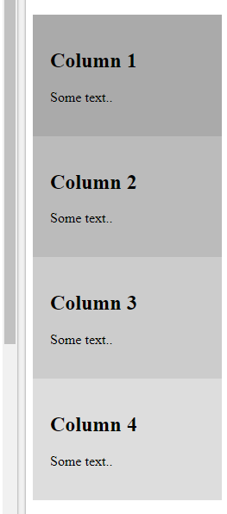
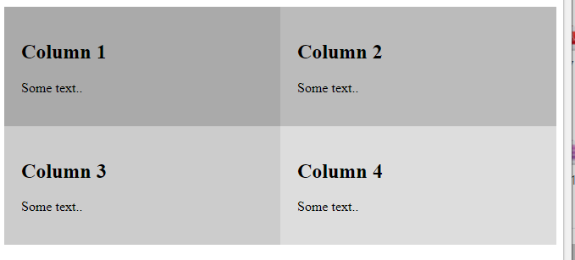
Responsive Four Column Layout Example
https://www.w3schools.com/css/css3_mediaqueries_ex.asp
When web browser is different sizes shows the site in various ways:

Slide 32
Writing Media Queries
/* Tablet Styles */
@media (max-width: 900px) {
.container {
width: 100%;
}
/* Other styling rules related to tablets go here */
}
/* Mobile Styles */
@media (max-width: 500px) {
/* Other styling rules related to mobiles go here */
}

Slide 33
Setting the viewport
This line of HTML will set the page’s viewport so that your media queries work across all devices:
<meta name="viewport" content="width=device-width, initial-scale=1, user-scalable=no">
HTML

Slide 34

Reading Week:
Short MDN Reading Tasks
BOX MODEL
https://developer.mozilla.org/en-US/docs/Web/CSS/box_model
MARGIN COLLAPSING
https://developer.mozilla.org/en-US/docs/Web/CSS/CSS_Box_Model/Mastering_margin_collapsing

